Slide 1
Data Mining Project
An efficient learning model
for short-term Stocks Prediction
By
Abhijeet Vichare (IU ID: abvichar@iu.edu)
Sylvia Boddu (IU ID: sboddu@iu.edu )

Slide 2



What inspired us to do this project..?
The uncertainty of the Stock market, which make it challenging to build any predictive model.
There are a couple of Deep Learning models that are implemented and inspired us to build and try new things.
Given this uncertainty there is enough research that proves the prediction can be done upto certain extent.

Slide 3
Data Set
https://www.kaggle.com/jacksoncrow/stock-market-dataset?select=stocks
The date for every symbol is saved in CSV format with common fields:
Date - specifies trading date
Open - opening price
High - maximum price during the day
Low - minimum price during the day
Close - close price adjusted for splits
Adj Close - adjusted close price adjusted for both dividends and splits.
Volume - the number of shares that changed hands during a given day
All that ticker data is then stored in the stocks folder. Moreover, each filename is the corresponding ticker symbol. At last, symbols_valid_meta.csv contains some additional metadata for each ticker such as full name.
5884 stocks with data from their inception till 04-2021. We limited the dataset from 01-2018 to 04-2020.

Slide 4
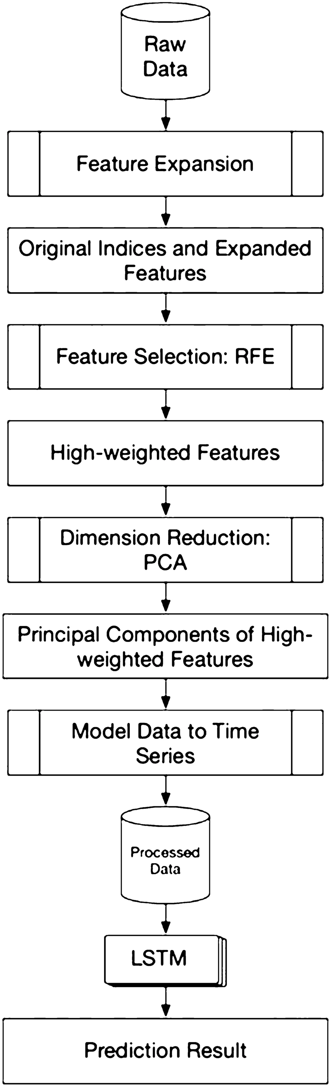
Architectural Flow

Slide 5
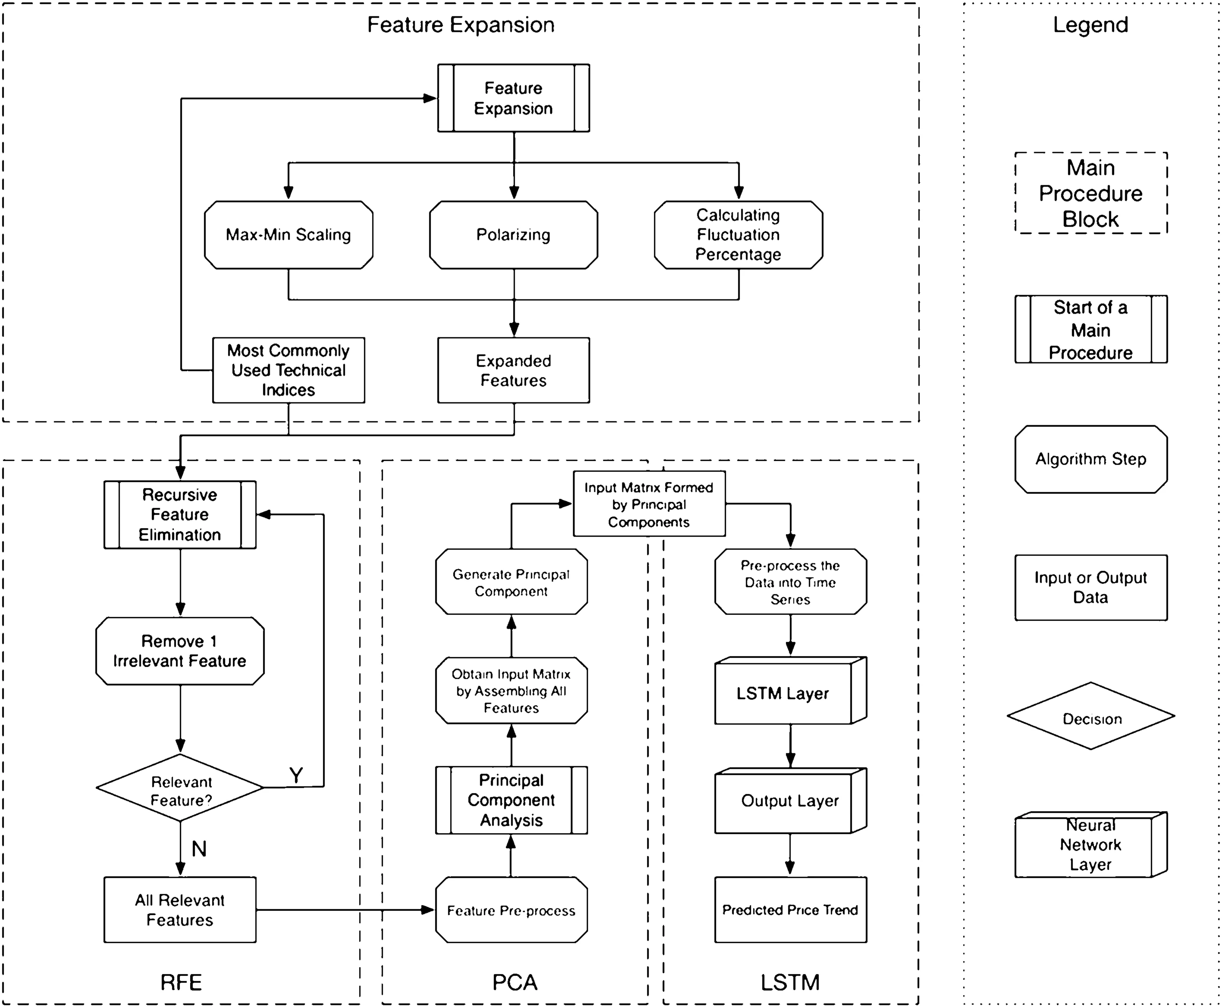
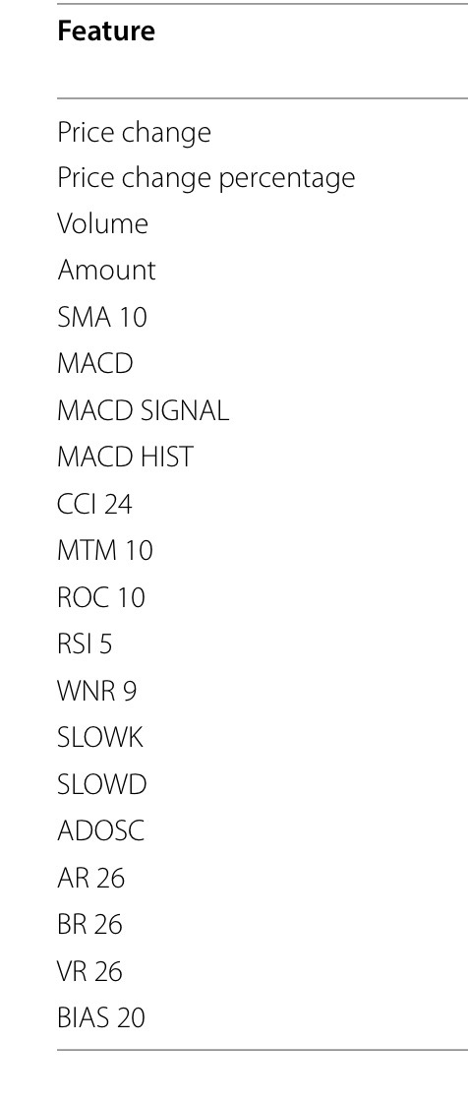
Major Pre-Processing Steps
Feature Engineering
Feature Scaling
RFE(Recursive Feature Elimination)
PCA

Slide 6
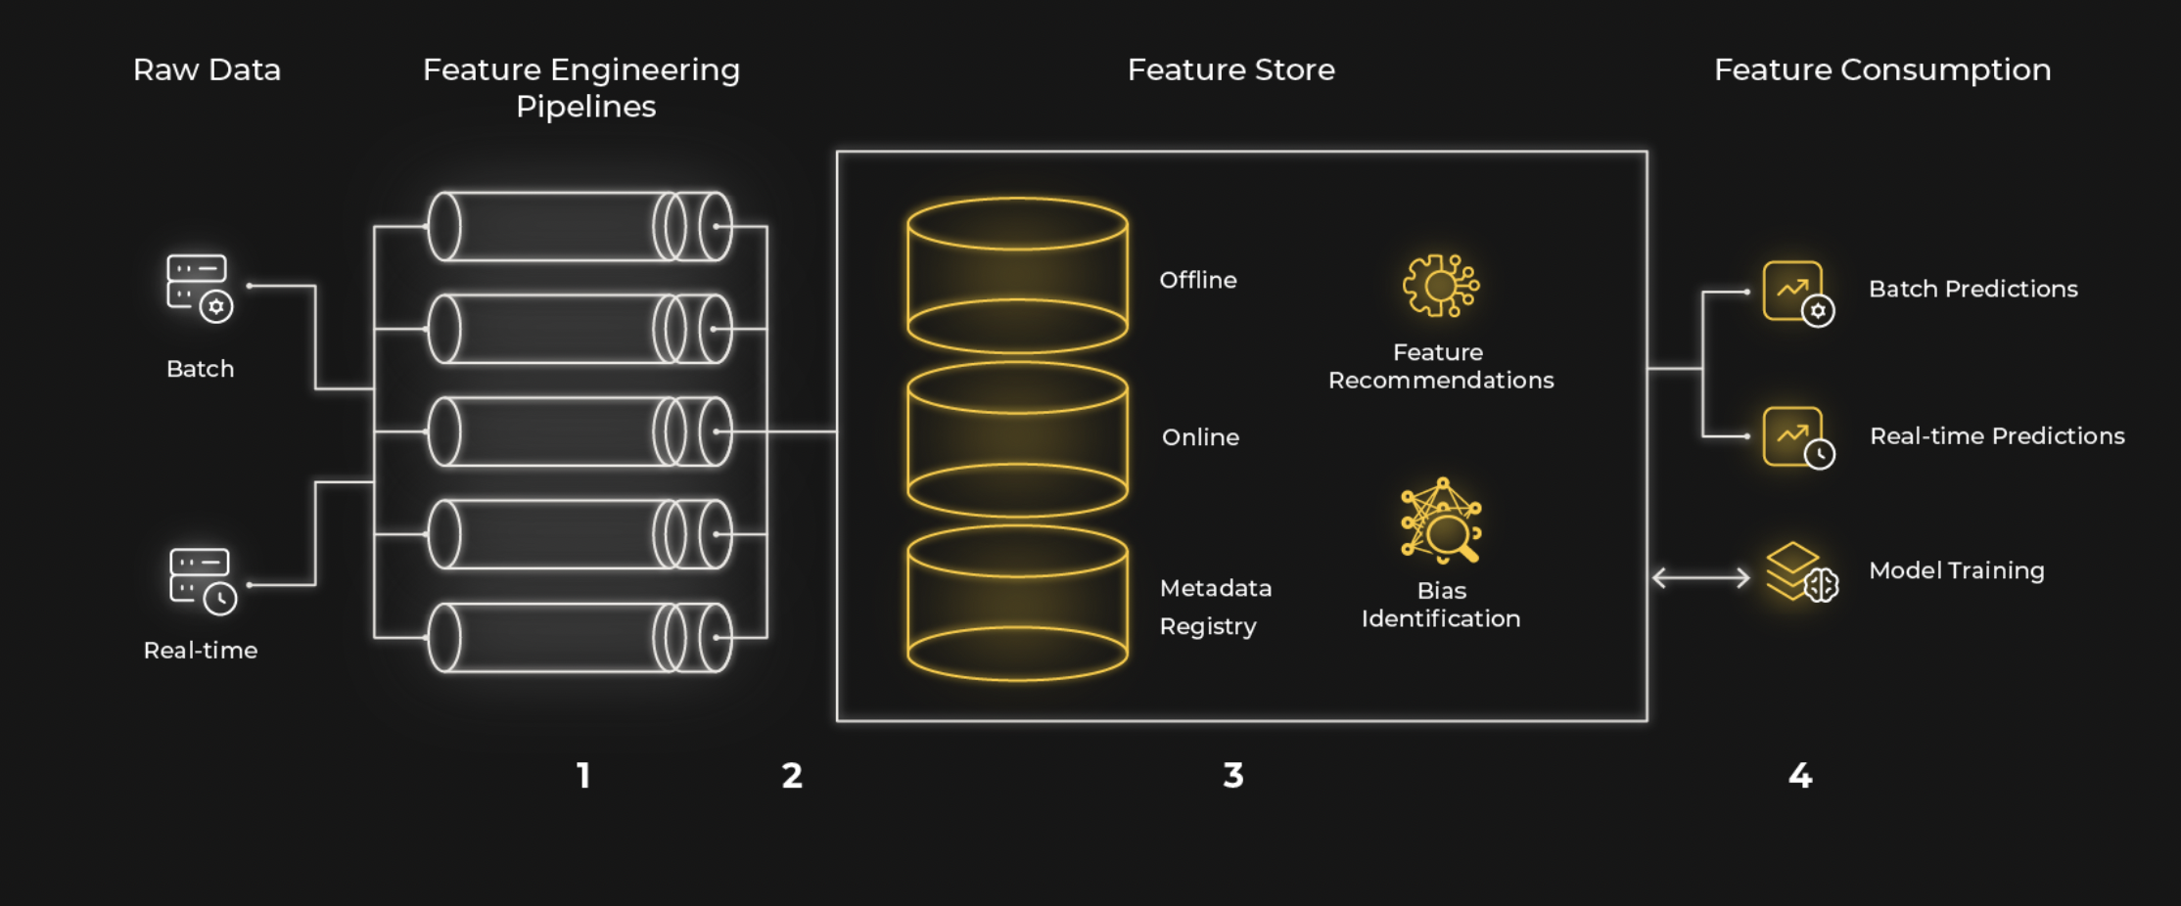
Feature Engineering
Feature engineering refers to the process of using domain knowledge to select and transform the most relevant variables from raw data when creating a predictive model using machine learning or statistical modeling. The goal of feature engineering and selection is to improve the performance of machine learning (ML) algorithms.
Feature Creation: Creating features involves identifying the variables that will be most useful in the predictive model.
Transformations: Transformation involves manipulating the predictor variables to improve model performance
Feature Extraction: Feature extraction is the automatic creation of new variables by extracting them from raw data
Feature Selection: Feature selection algorithms essentially analyze, judge, and rank various features to determine which features are irrelevant and should be removed,

Slide 7
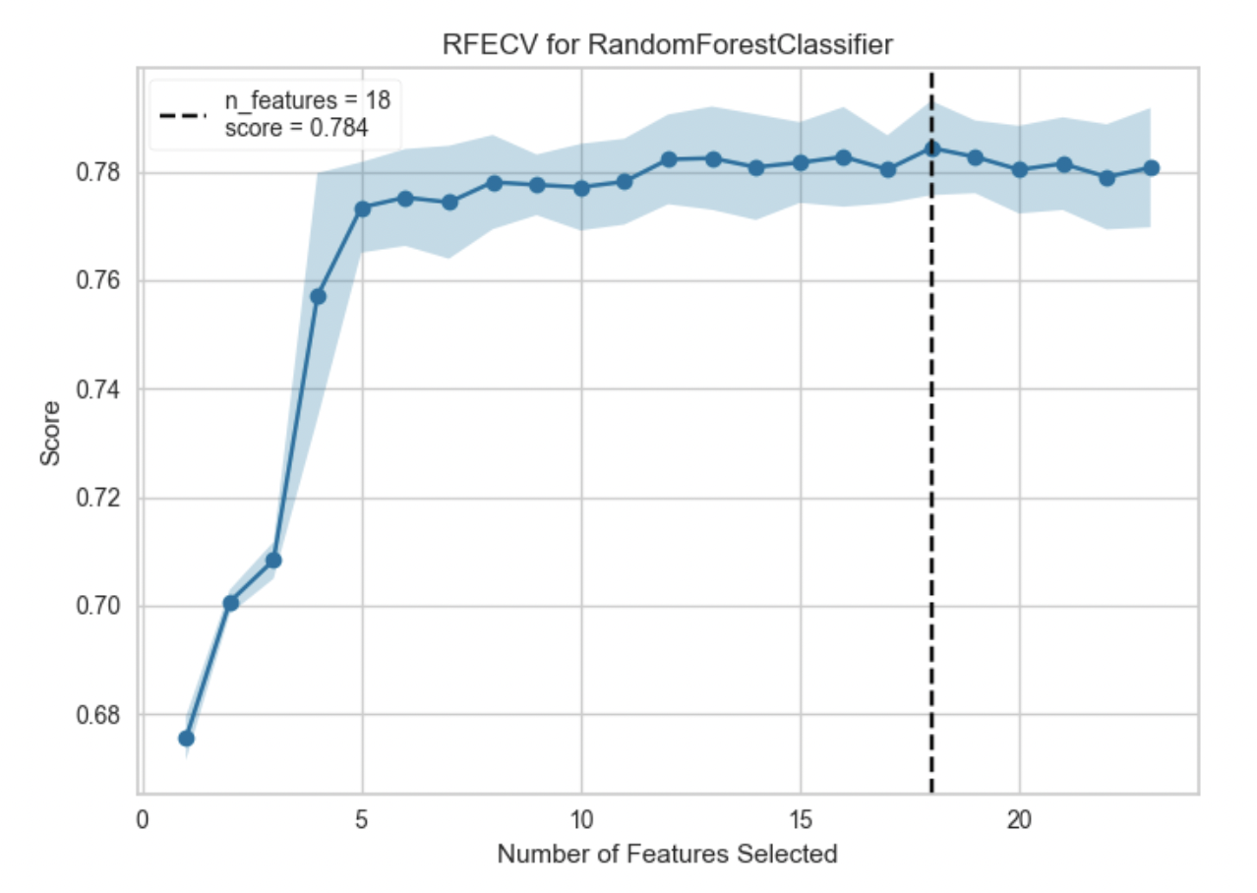
Recursive Feature Elimination
Recursive feature elimination (RFE) is a feature selection method that fits a model and removes the weakest feature (or features) until the specified number of features is reached. Features are ranked by the model’s coef_ or feature_importances_ attributes, and by recursively eliminating a small number of features per loop, RFE attempts to eliminate dependencies and collinearity that may exist in the model.
RFE requires a specified number of features to keep, however it is often not known in advance how many features are valid. To find the optimal number of features cross-validation is used with RFE to score different feature subsets and select the best scoring collection of features. The RFECV visualizer plots the number of features in the model along with their cross-validated test score and variability and visualizes the selected number of features.

Slide 8
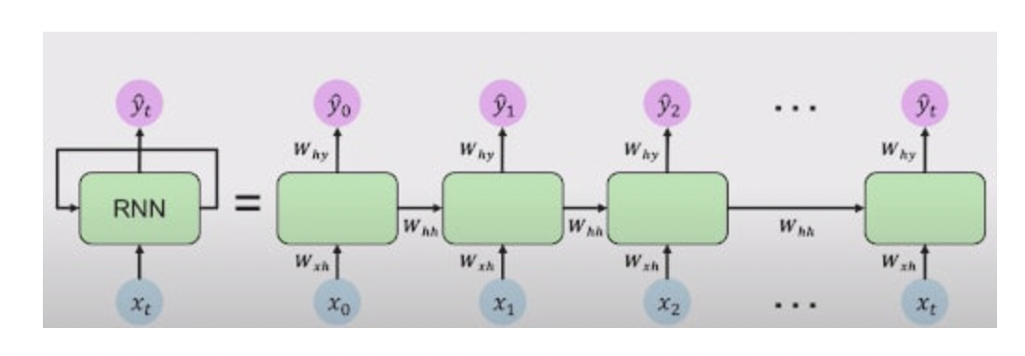
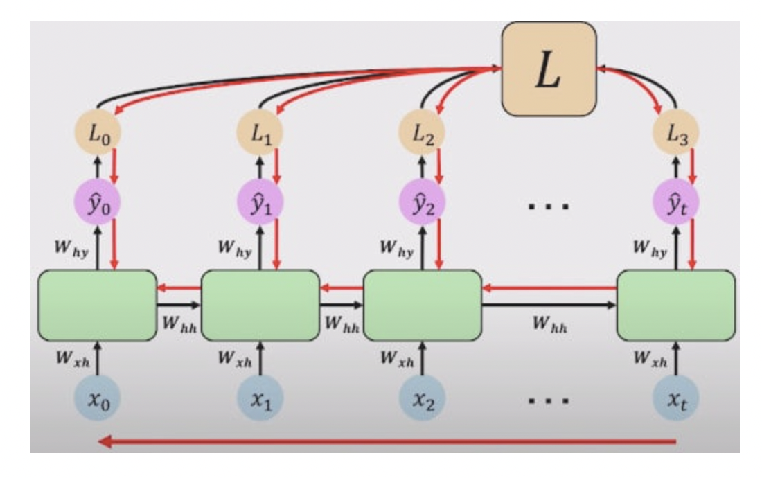
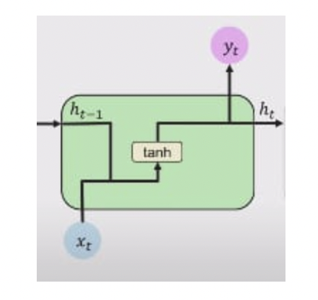
LSTM(Long Short Term Memory)
To grasp the concept and importance of LSTM, you’ll need to understand why we need LSTM. What are the limitations of other Neural Network architectures that made us feel that we need another architecture that is suitable for processing Sequential Data.For this, you’ll also need to understand the working and shortcomings of Recurrent Neural Networks (RNN), as LSTM is a modified architecture of RNN.

Slide 9
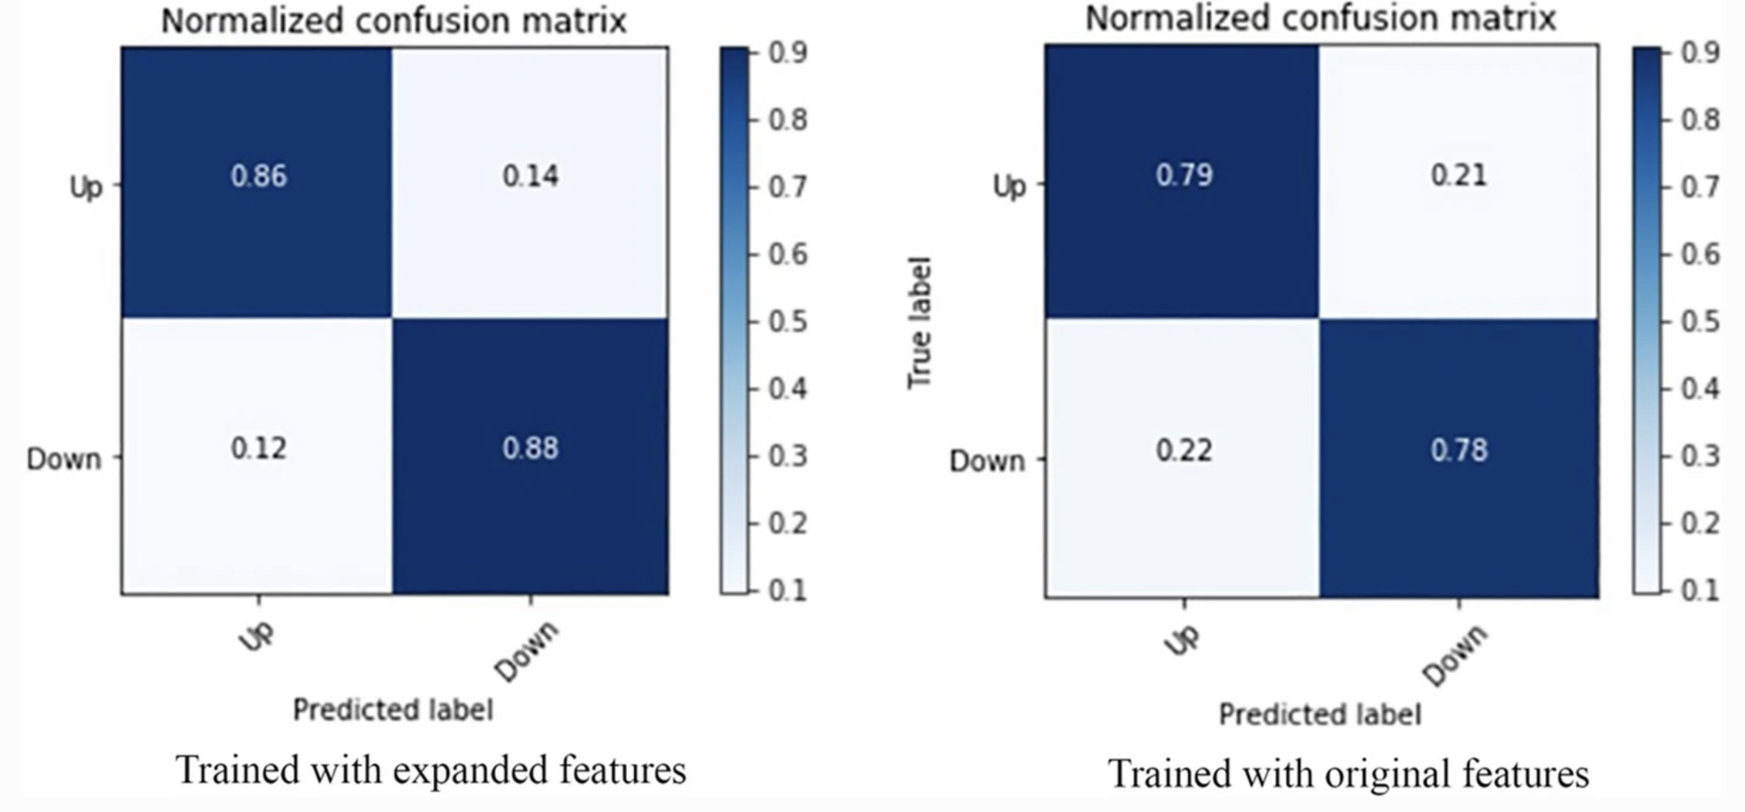
Expected Results
Features are expected to improve the prediction accuracy on an average by 7%.

Slide 10
Further STEPS
Currently we are facing issues in running the LSTM on local systems. WE are planning to migrate the code on google Collab.
WE are planning to leverage other stocks with similar mechanism to improve the prediction accuracy.

Slide 11
Thank You

